Slide 1


Basic Stamp Final Project-
7 Segment Hex Counter
1
BY: Corey Rice & Everett Barry Jr.
EECT 112 50c
Fall 2015

Slide 2
Table Of Contents
2
Title Slide
Table of Content
Reasons for Choosing Project
Objective
Parts/Supplies
Schematic
Data Sheet for MAN74A
Photo
Video
Basic Stamp Code
Research
Challenges/Issues
The End
1
2
3
4
5
6
7
8
9
10-11
12
13
14

Slide 3

Reasons For Choosing Project
3
It looked like a more simple assignment.
We wanted to use are knowledge of hexadecimal and binary counting.
We simulated a similar circuit design in Multi-SIM previously.

Slide 4
Objective
4
1
2
3
The LEDs must loop around the outside of the display approximately 5 times in 2 seconds.
Count up from “0” to “F”.
Once the counter reaches “F”, it must flash ON for 1 second, then OFF for 1 second, twice.
Count back down from “F” to “0”.
Once the counter reaches “0”, it must flash ON for 1 second, then OFF for 1 second, twice.
Repeat From the Beginning, Step 1.
4
5
6

Slide 5
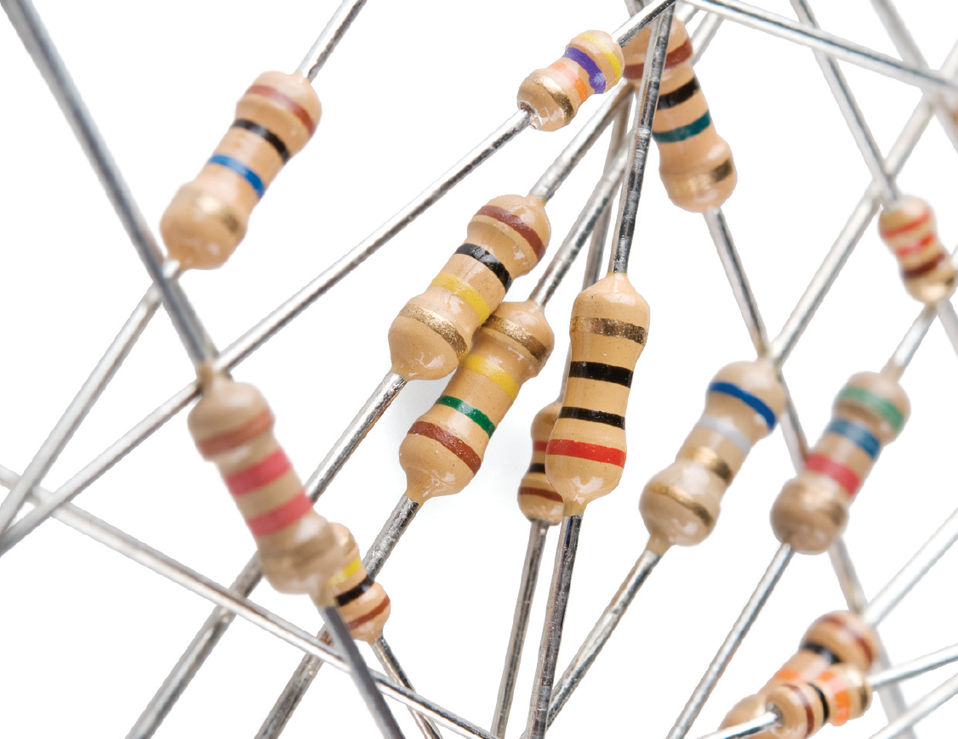
Parts/Supplies
5
1-Basic Stamp Software
1-Basic Stamp Board
1-MAN74A
8-Wires
1-150Ω Resistor
1-Power Cable
1-Serial Cable
1-Computer

Slide 6
Schematic
6

Slide 7
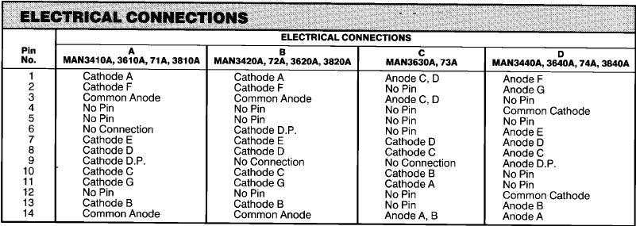
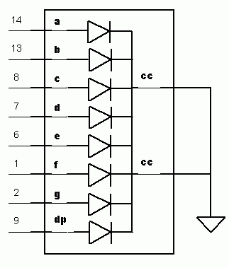
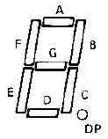
Data Sheet MAN74A
7

Slide 8
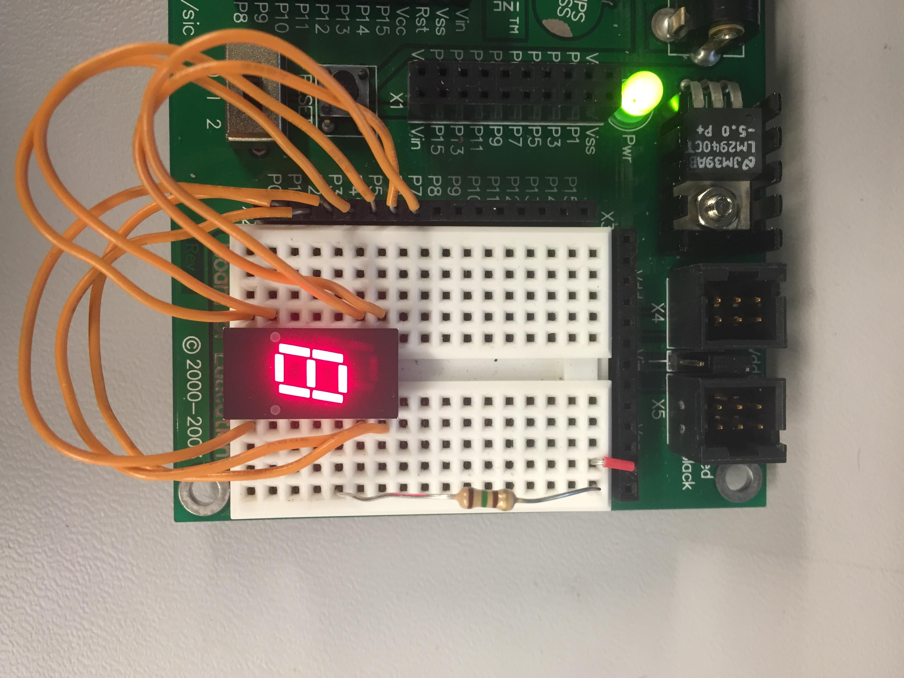
Finished Design
8

Slide 9
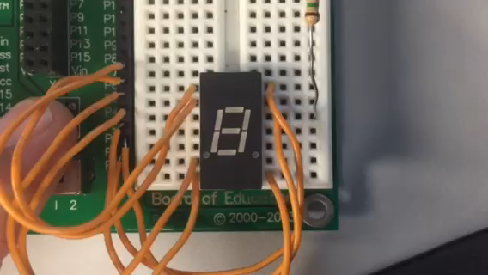
7-Segment HEX Counter In Action
9

Slide 10
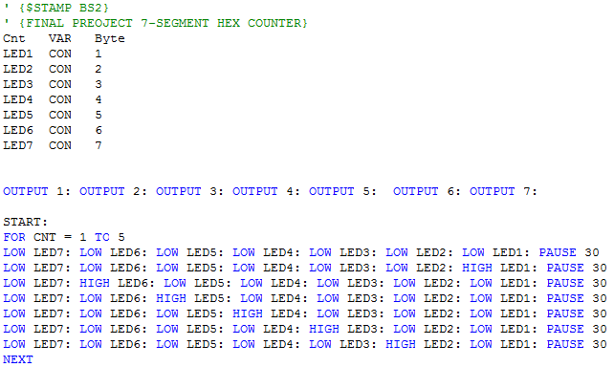
Basic Stamp
Code (1 of 2)
10

Slide 11
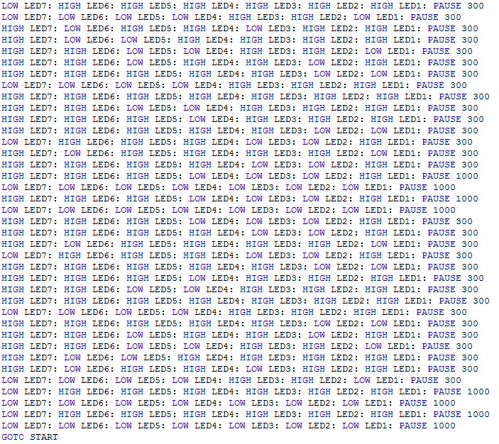
Basic Stamp
Code (2 of 2)
11

Slide 12


Research
12
MAN74A Data Sheet
www.ivytechengineering.com
Basic Stamp Manual Version 1.9

Slide 13

Challenges/Issues
13
We originally start with a MAN6780 Display, but it was very dim and only half of the 7 leds on it would light up.
Once it was replaced with a MAN74A we had to rewire are inputs so they would match up with are new display.

Slide 14

Complaints?
Questions?
14
Comments?
Compliments?

